Slide 1
Scholarly Insights Project Progress
Bits & Insights
Nobodit Choudhury, Ayana Felix, Josephine Odusanya, Quincy Oldland, Xiangjian Zeng, Katherine Zhuo

Slide 2
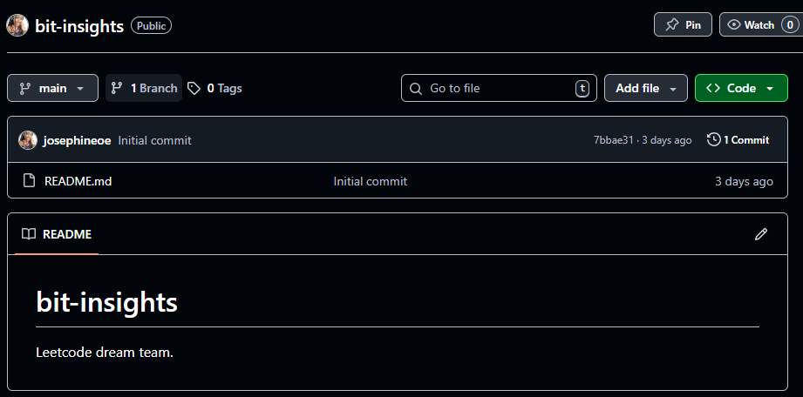
Dev Environment
Github: We will all submit push our contributions to Github using the shared repository bit-insights (Leetcode Dream Team).

Slide 3
Database Schema
Users: stores info about registered users and their preferences
Articles: holds metadata about articles
Search History: tracks user searches for personalization and analytics
Saves Articles/Favorites: allows users to bookmark articles relevant to them
Comments: allows users to annotate articles
Notes:
Include wireframes for final presentation

Slide 4
Backend Framework
Flask
Lightweight and flexible Python web framework
Fast for prototyping APIs
Good integration with databases (e.g., MongoDB)

Slide 5
Next Steps
Article Search with arXiv API
Feature Implementation: Search, Article Information, User Accounts
Explore Firebase for user authentication
Integration and Testing
Notes:
Describe search algorithm and other features in more detail

